Slide 1
Sentiment analysis
Course: Natural Language Processing And Pattern Recognition Instructor: Dr.Mohammad Bani Doumi
Done By :Zain Dimes , Renad Imraiziq , Kamal Hasan , Laith Aljallad

Slide 2
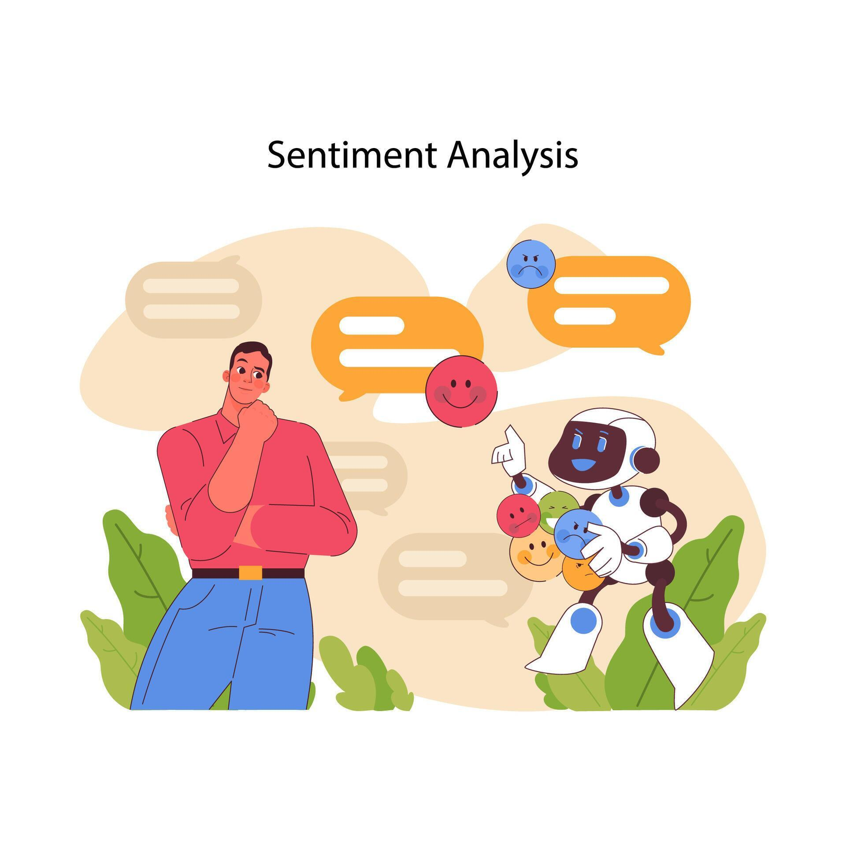
Introduction
Natural Language Processing (NLP) helps computers understand human language.
One common NLP task is sentiment analysis:
Sentiment analysis identifies emotions in text ,It classifies text into :
positive:satisfaction and good experience
negative:complaints or dissatisfaction
neutral :no strong emotional expression

Slide 3
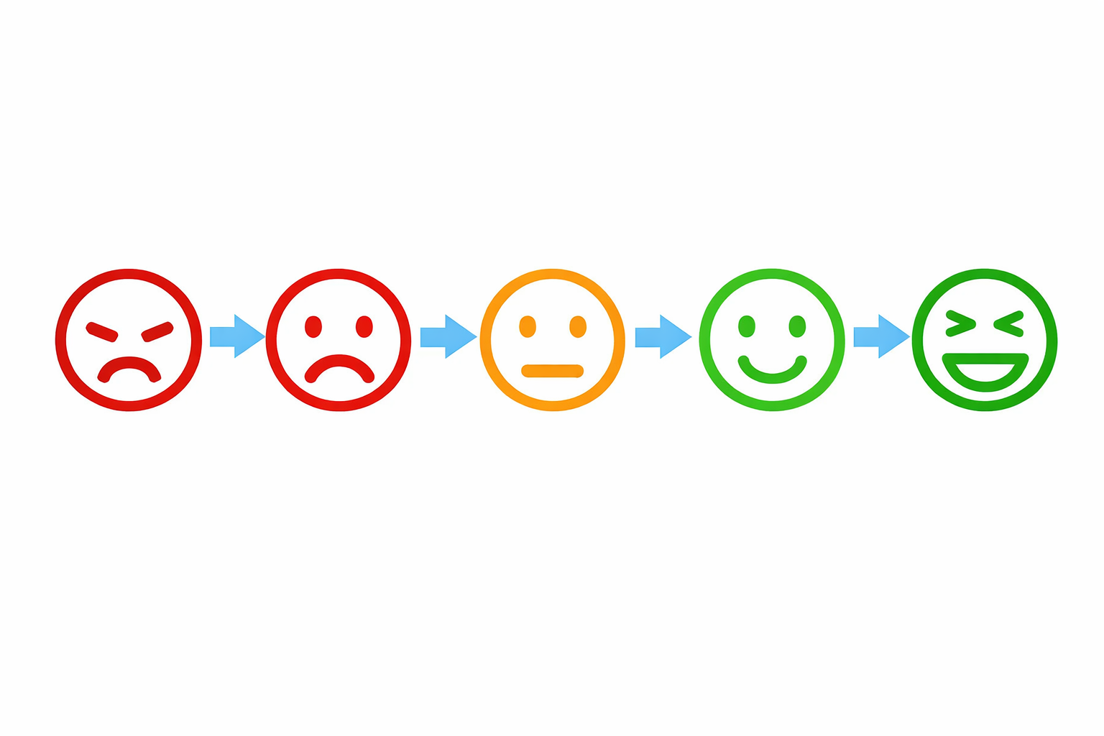
Why Sentiment Analysis
Text data often contains opinions, emotions, and personal experiences that reflect people’s attitudes.
Analyzing large amounts of text manually is difficult and time-consuming.
Sentiment analysis is used to automatically identify emotions in text.
It classifies text into clear categories: positive, negative, and neutral.
In healthcare, sentiment analysis helps analyze patient feedback and evaluate service quality.

Slide 4
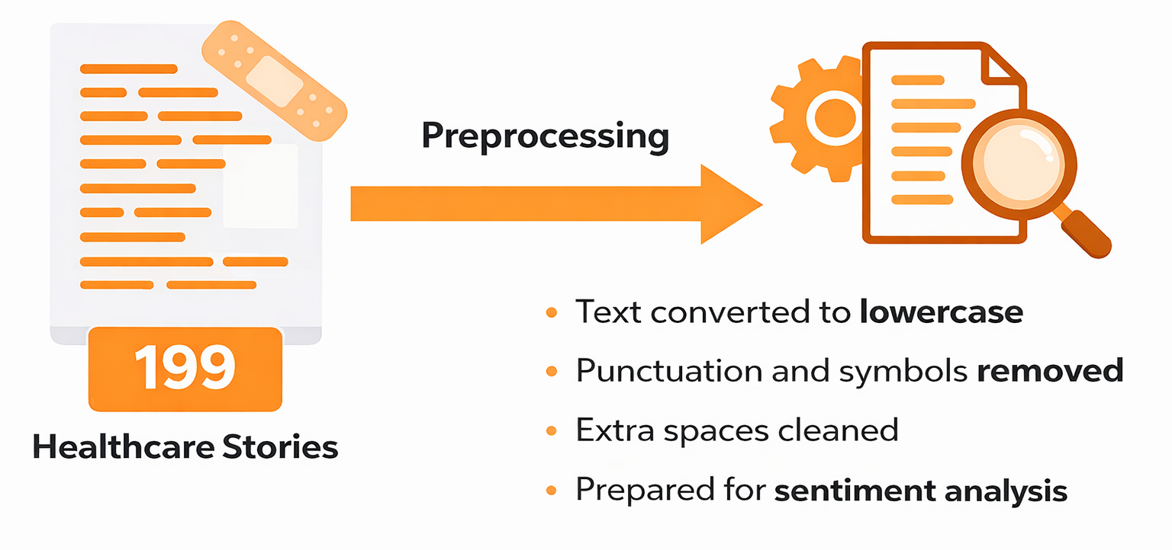
Dataset & Preprocessing
Dataset collected from hospital services. ,Contains 199 textual entries.Each story describes a hospital or healthcare experience
Preprocessing steps:

Slide 5
Methodology
Since the provided dataset consists of unlabeled text, we adopted an Unsupervised Lexicon-Based approach using the TextBlob library.
Sentiment Scoring: The model calculates a "Polarity Score" for each story based on a predefined lexicon of adjectives and phrases. The score ranges from -1.0 (Most Negative) to +1.0 (Most Positive).
Classification Logic:
Positive: Polarity Score > 0
Negative: Polarity Score < 0
Neutral: Polarity Score = 0

Slide 6
Model Validation
A random sample of 10 stories was manually labeled and compared with TextBlob predictions. The validation achieved an accuracy of 60%, suggesting that more advanced models could improve accuracy
Sample Validation Results :
ID | Story Snippet (First Words) | Model Prediction | Manual Label | Result
34 | "I have struggled with ocd for many years... But at Bromley..." | Positive | Positive | ✅ Match
64 | "Impossible to contact by phone... No option at all just engaged..." | Negative | Negative | ✅ Match
31 | "I felt desperate... But since having counselling... Depression has lifted." | Negative | Positive | ❌ Mismatch
24 | "I had to go for a CT scan and cannot thank the staff enough..." | Neutral | Positive | ❌ Mismatch

Slide 7
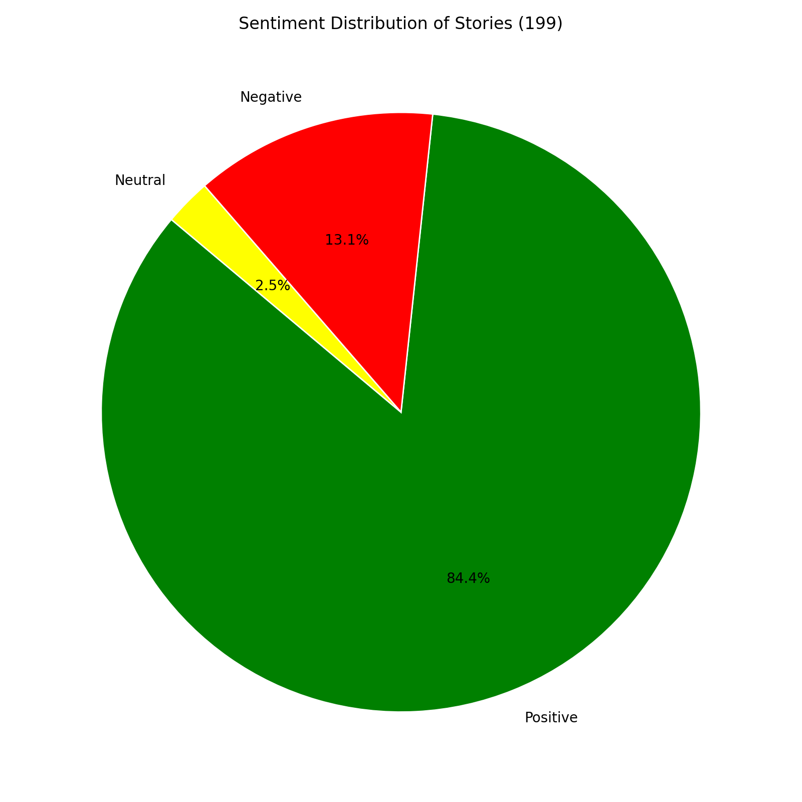
Results

Slide 8

Discussion
The pie chart shows that positive sentiment is dominant, representing 84.4% of the stories (168 out of 199). This indicates that most patients reported positive experiences with hospital services.
Negative sentiment accounts for 13.1% (26 stories), showing that dissatisfaction exists but is relatively limited. Neutral responses are very low at 2.5% (5 stories), meaning most patients expressed clear opinions.
Overall, the results suggest that hospital services are generally perceived positively.

Slide 9
Conclusion
Sentiment analysis was successfully applied to healthcare patient stories using NLP techniques. The results showed that most patient opinions were positive, indicating overall satisfaction with hospital services. NLP methods helped efficiently analyze and summarize large amounts of feedback, and the sentiment charts provided clear visual insight into patient experiences. Manual validation showed that more advanced models could improve accuracy.

Slide 10


